Slide 1
Sprint Review
Project : Document Tag Generator
Sprint : 01
Start Date : 22/02/2022
End Date : 03/02/2022
Product Owner : Mr. Nuwan Jaliyagoda
Scrum Master : Mr. Thushara Bandara
Team Members :
E/17/100 Gunathilaka R.M.S.M.
E/17/246 Perera K.S.D
E/17/284 Rathnayaka R.L.D.A.S

Slide 2
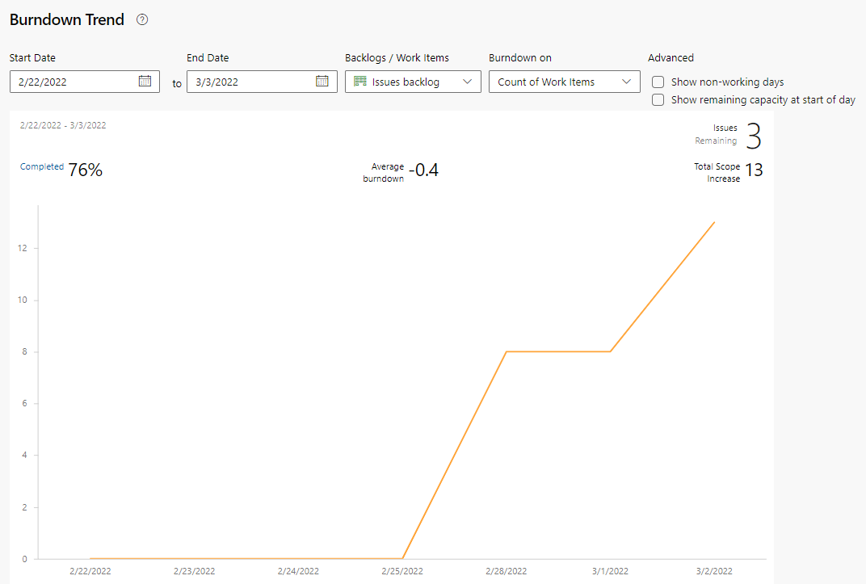
Sprint Report
Number of backlog items : 13
Number of completed items : 10

Slide 3
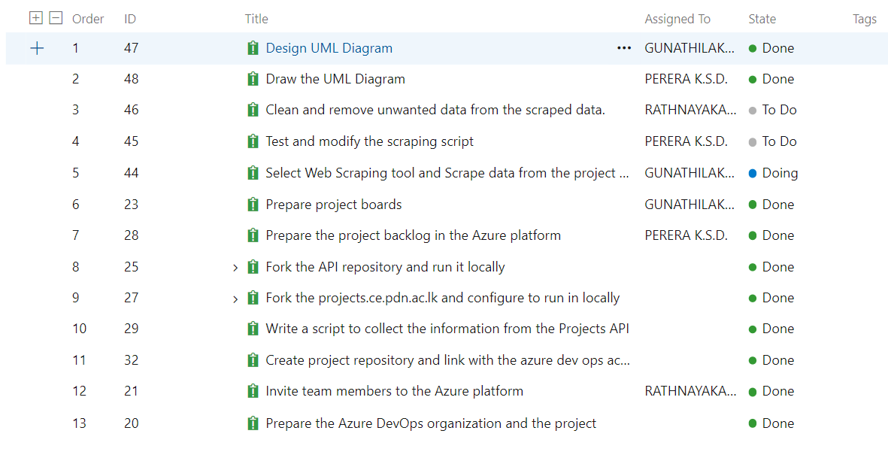
Sprint Report

Slide 4
Current Progress
Number of remaining tasks : 3
Select Web Scraping tool and Scrape data from the project website.
Test and modify the scraping script.
Clean and remove unwanted data from the scraped data.

